Slide 1
Invisibility Cloaks
Dilraj Ghuman

Slide 2
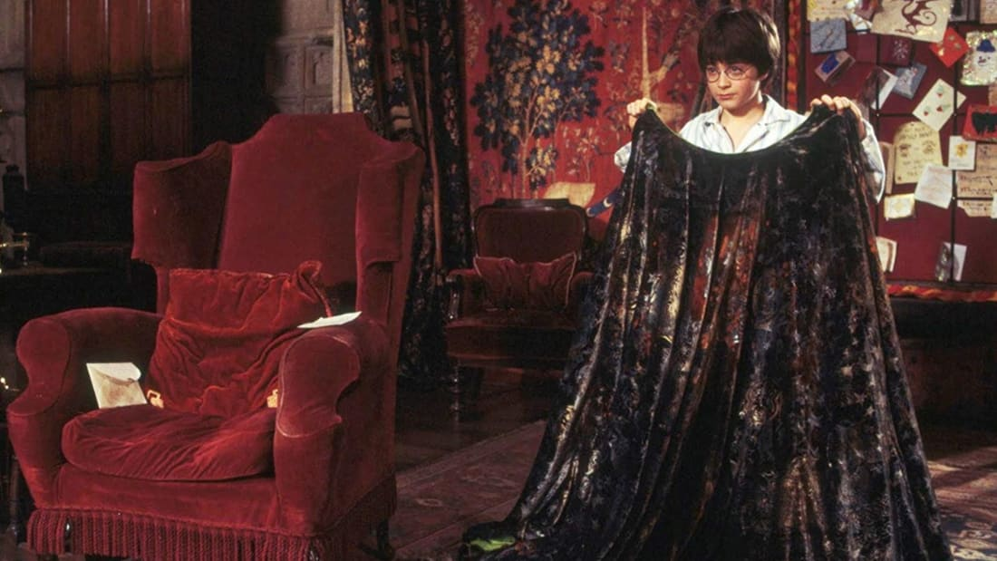
Notes:
Purpose: to bend light such that it passes by an object
Does not go through the object
Observer should see light unchanged
Ideally, works on all wavelengths
Anecdote: Harry shouldn’t be able to see! But Magic…

Slide 3
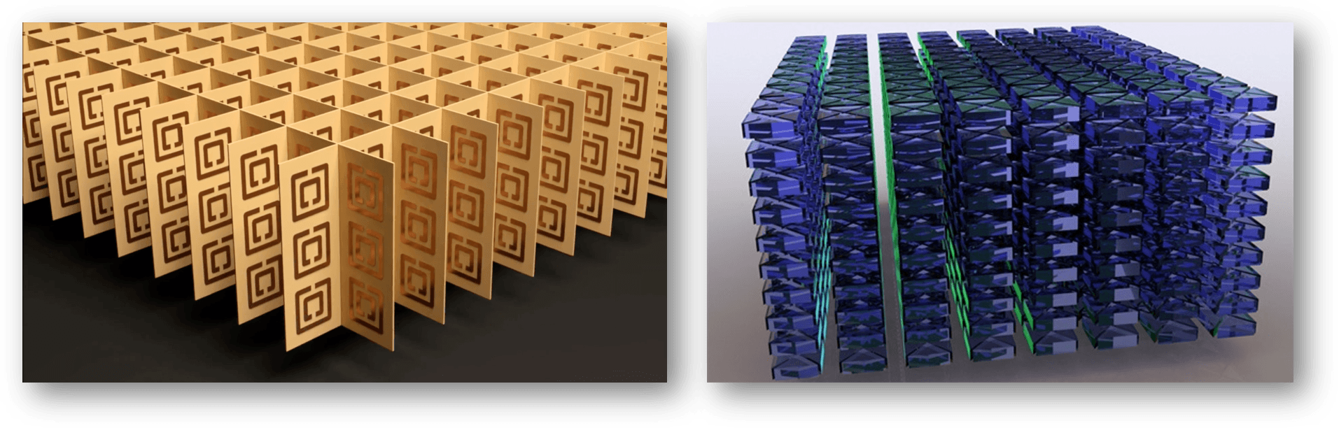
Metamaterials
Credit to http://www.metamaterial.com
Notes:
Not observed in nature
Structure is more important than composition
Relies heavily on nanostructure
Allow us to control the refractive index (permeability and permiativity)
Work by have structures on scale with the wavelength

Slide 4
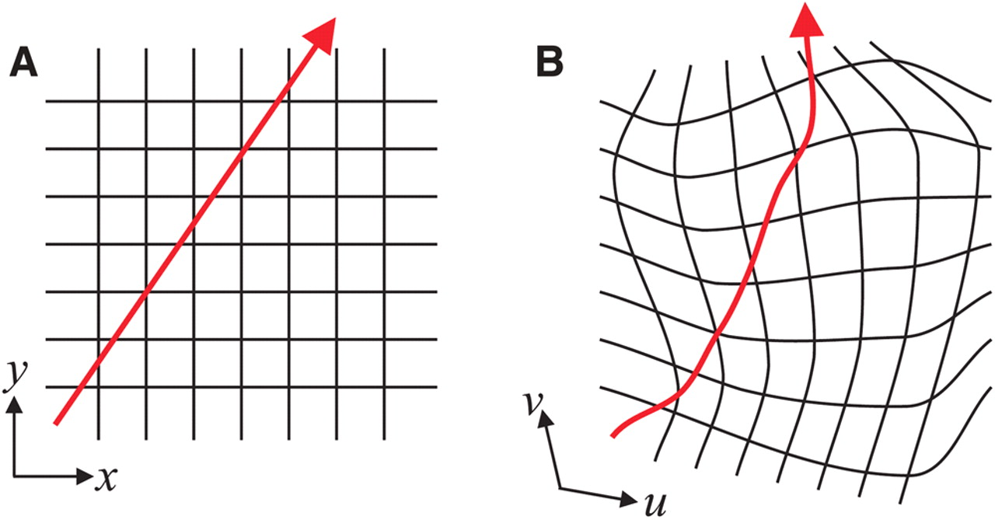
Transformation Optics
E & M + Metamaterials
Credit to https://science.sciencemag.org/content/312/5781/1780.full
Notes:
Work by combining EM , metamaterials and coordinate transforms
Maxwell’s equations don’t change under transforms, but permeability and permittivity do
Mapping light to a particular path requires we fix a coordinate transform, then find the permeability and permittivity needed

Slide 5
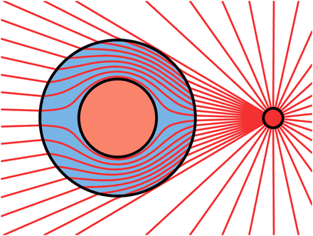
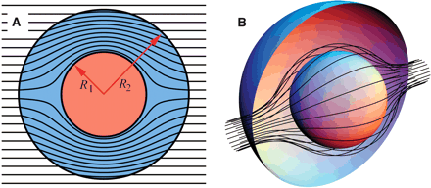
Transformation Optics
Credit to https://science.sciencemag.org/content/312/5781/1780.full

Slide 6
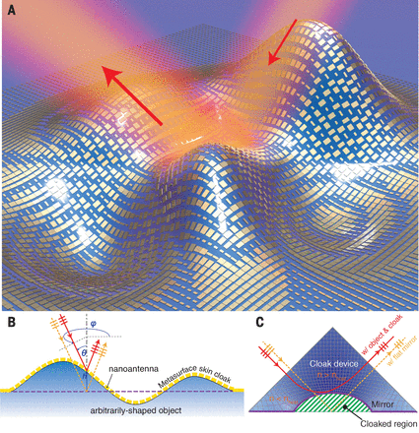
Previously Completed Cloaks
2D Microwave Cloak
Single-Frequency
Transverse Electric Waves (TE)
Carpet Cloaks
Cloaks objects on a plane
Uses a reflective surface

Slide 7
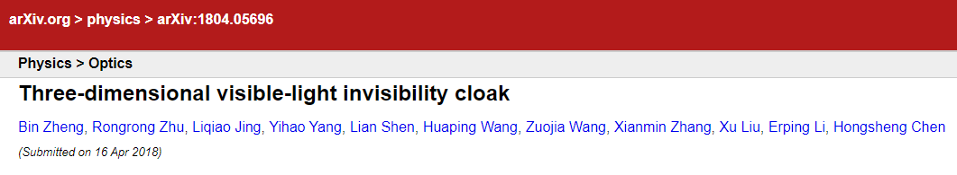
Application

Slide 8
Set Up
Cloak + Object
Screen
Light
Light

Slide 9
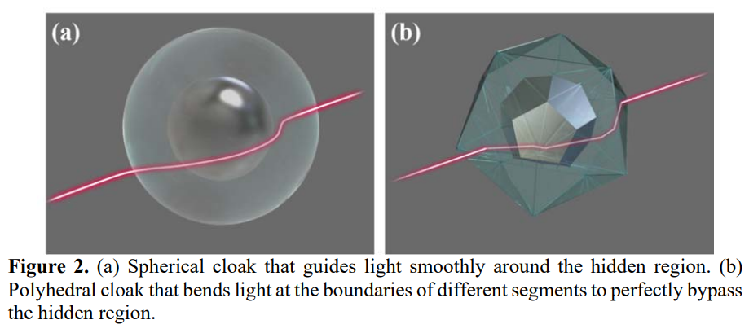
Set Up

Slide 10
Set Up
12 Tetrahedral pieces of glass (ZLaF78) with permittivity 3.61
Enclosed by 8 heptahedral pieces of glass (ZBaF1) with permittivity 2.63
Regions between filled with water
Makes a cube!

Slide 11
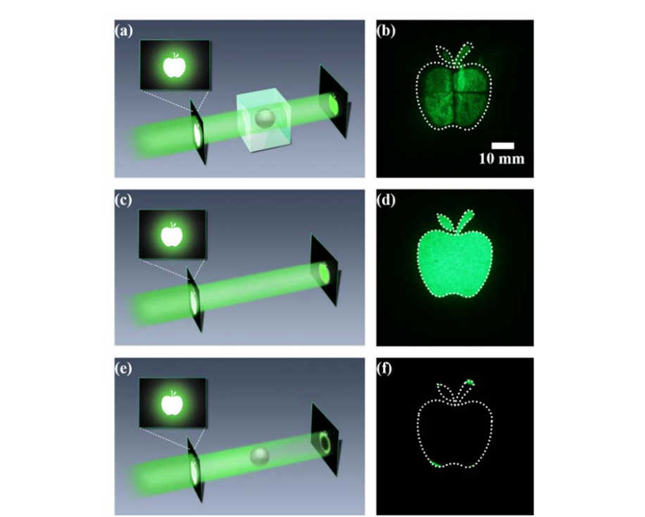
Results

Slide 12
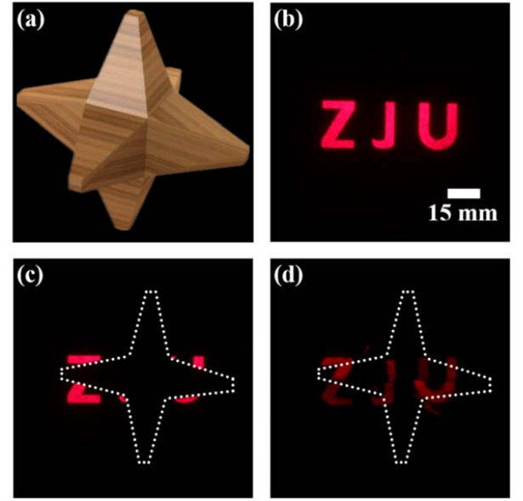
Results

Slide 13
Conclusions
Far from practical consumer invisibility cloaks
Room for improvement!
It would be nice to see the experiment done with a multitude of visible wavelengths
Improved to cloak from all viewing angles
Transformation Optics and Metamaterials are a growing field of study

Slide 14
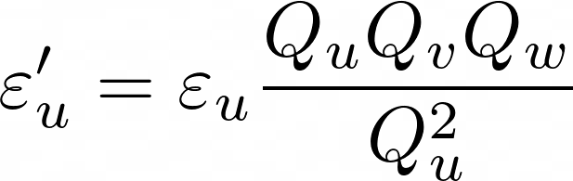
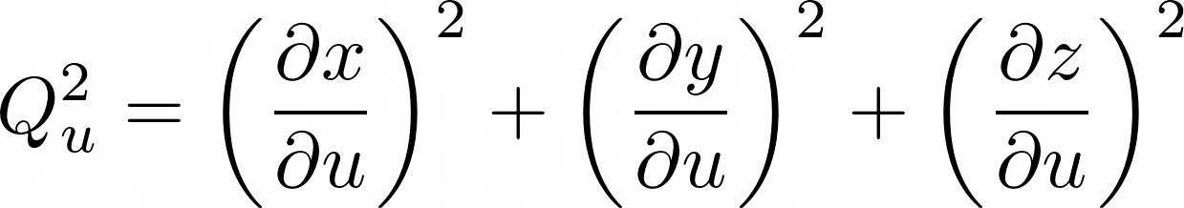
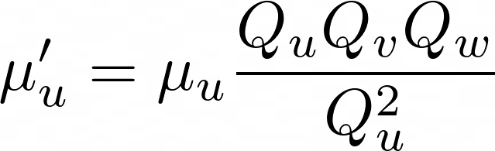
Transformation Optics
Smooth Maps

Slide 15
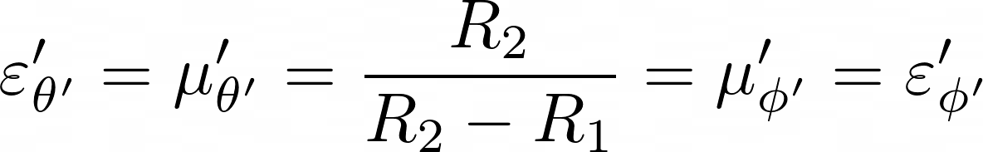

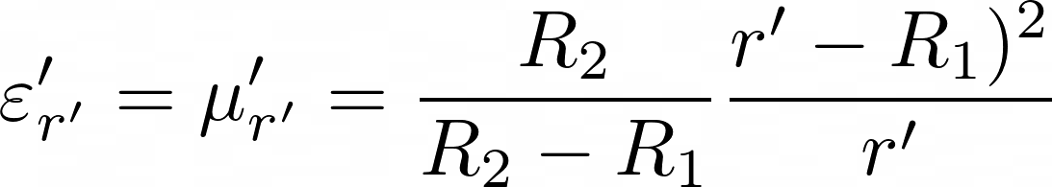

Transformation Optics

